Slide 1



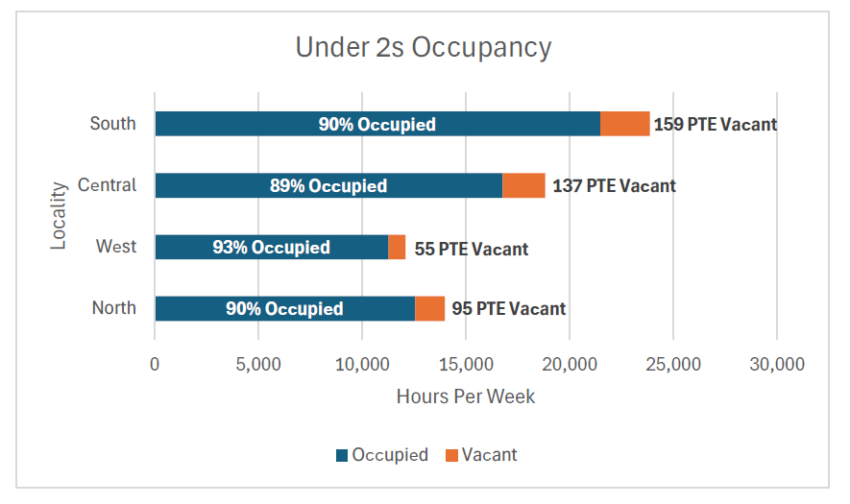
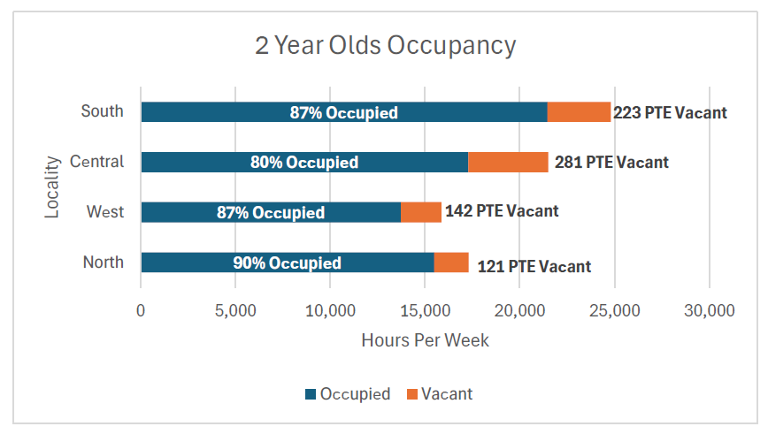
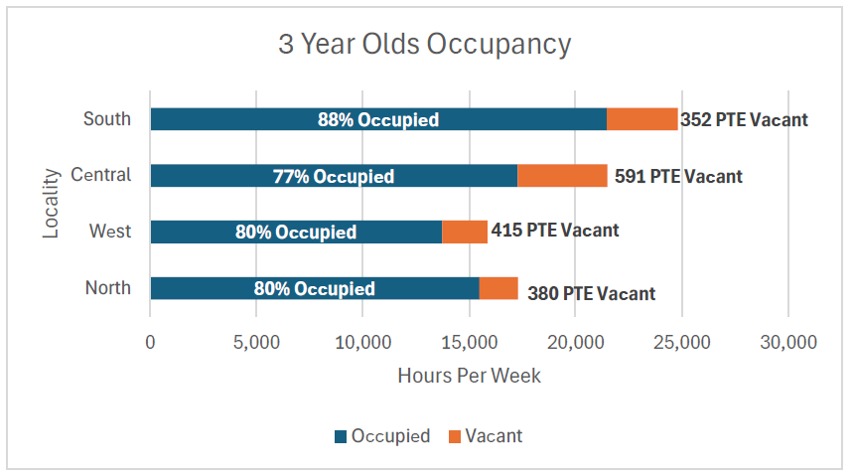
Trafford Early Education & Childcare
Sufficiency - Spring 2025
There are 13,462
children aged 0 to 4
in Trafford
(national statistics)
98%
of Early Education Providers are Ofsted
rated Outstanding
and Good (2024)
Declining birth rate in Trafford. Population percentage change in age 0 to 4, between 2021 and 2024 is -6.60% (Trafford Data Lab)
80.7%
of the working age population are in
employment (Nomis web)
2 YEAR OLD FUNDING
AVERAGE COST
(2025 Coram survey)
AVERAGE OPENING HOURS (Jan 2025 EY Census)
280
individual children funded
13%
of funded places are children from outside of the borough. Trafford is a net importer.
of eligible 2 year olds are taking up a place in Trafford
72%
Day Nursery
£53.87 per day
Childminder
£43.64 per day
Day Nursery
Childminder
Open: 7:30am
Close: 6.00pm
Open: 7:30am
Close: 5.30pm
Children aged 0-4 with Special Educational Needs and Disabilities
131 in receipt of Early Years SEND Funding
86 in receipt of Disability Access Funding
21 in special school nursery assessment places
46 requested an EHC needs assessment
19 with an EHC Plan
205 supported by SEN Advisory Service
199 providers can deliver 2 year old funding:
24%
of PVI providers delivering Early Education funding have at least 1 graduate leading practice.
3&4 YEAR OLD FUNDING
262 Early Education Providers
107
Childminders
68
Day Nurseries
58 mainstream and 3 special school nurseries
21
Pre-Schools
5 Independent school Nurseries
3342
3&4 year olds taking up a universal funded place
2019
3&4 year olds taking up an extended funded place
7%
of children received Early Years Pupil Premium in spring 25
Working Parent Entitlement Rollout for 2 Year Olds and Under
15 hours per week implemented.
On track to roll out 30 hours per week from 1 September 2025
262 providers can deliver 3 & 4 year old funding:
Occupancy

